Slide 1

LINQ to SQL
Radoslav Kirilov
Tsvyatko Konov
National Academy for Software Development
National Academy for Software Development
academy.devbg.org
academy.devbg.org

Slide 2

Contents
Introduction to object-relational mapping (ORM) technologies
Introduction to LINQ to SQL
Using Visual Studio LINQ to SQL Designer
Using DataContext
Reading data from LINQ to SQL
Creating, updating and deleting data from LINQ to SQL

Slide 3
Introduction to ORM technologies

Slide 4
ORM Technologies
Object-relational mapping is a programming technique for converting data
  Between incompatible type systems
  In relational databases and object-oriented programming languages
This creates a "virtual object database"
  Which can be used from within the programming language

Slide 5
ORM Technologies (2)
Data management tasks in object-oriented programming are typically implemented
  By manipulating objects, which are almost always non-scalar values
An ORM implementation should systematically and predictably choose
  Which tables to use
  And generate the necessary SQL

Slide 6
ORM Advantages
Object-relational mapping advantages
  Performance
  Linear scalability
  Manageability of the CRUD operations for complex relationships
  Application maintainability
  Flexibility

Slide 7
LINQ to SQL and ORM
LINQ to SQL is a component of .NET Framework version 3.5
Provides a run-time infrastructure for managing relational data as objects
The data model of a relational database is mapped to an object model
  Expressed in the programming language of the developer

Slide 8
LINQ to SQL and ORM (2)
When the application runs
  LINQ to SQL translates into SQL the language-integrated queries in the object model
  And sends them to the database for execution
When the database returns the results
  LINQ to SQL translates them back to objects
  That we can work with in our own programming language

Slide 9
ORM Designer
Developers using Visual Studio typically use the Object Relational Designer
Which provides a visual design surface for creating LINQ to SQL entity classes
  And associations (relationships) that are based on objects in a database

Slide 10
Introduction to LINQ to SQL

Slide 11
Introduction to LINQ to SQL
LINQ to SQL is an application programming interface (API)
For working with SQL Server databases
LINQ to SQL is Microsoft’s entry-level LINQ-enabled ORM implementation for SQL Server
LINQ to SQL only works with SQL Server or SQL Express

Slide 12
Introduction to LINQ to SQL (2)
Most ORM tools attempt to abstract the physical database into business objects
With that abstraction, we typically lose the ability to perform SQL queries
With LINQ we do not get only the convenience of business objects that are mapped to the database
We get a full blown query language, similar to the already familiar SQL

Slide 13
LINQ Components
The DataContext
  The class that establishes a connection to a database
  It provides several services that provide identity tracking, change tracking, and change processing
Entity Classes
  Each database table is typically mapped to a single entity class

Slide 14
LINQ Components (2)
Associations
  An association is the term used to designate a primary key to foreign key relationship between two entity classes
Concurrency Conflict Detection
  One of the valuable services that the DataContext is performing for you is change processing
Concurrency Conflict Resolution
  Resolve the concurrency conflict

Slide 15
Using Visual Studio LINQ to SQL Designer

Slide 16
LINQ To SQL Designer
To create LINQ To SQL:
  Right click on Your project and choose Add >> New Item
  Choose LINQ to SQL Classes file
  From Server Explorer Create New Connection and set server and database name you want to connect to
  Finally drag the desired tables and stored procedures from Server Explorer

Slide 17
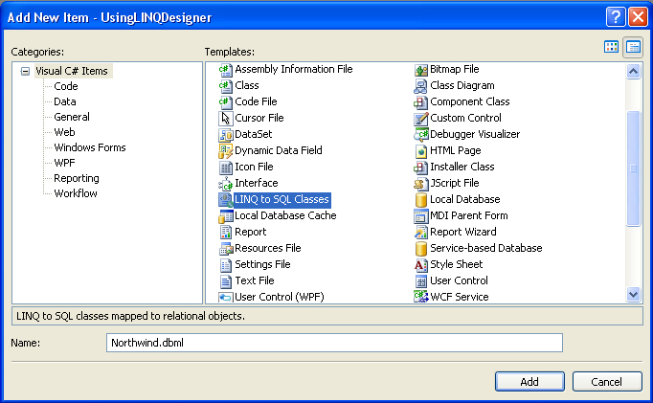
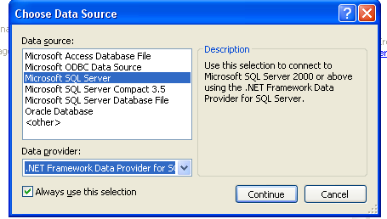
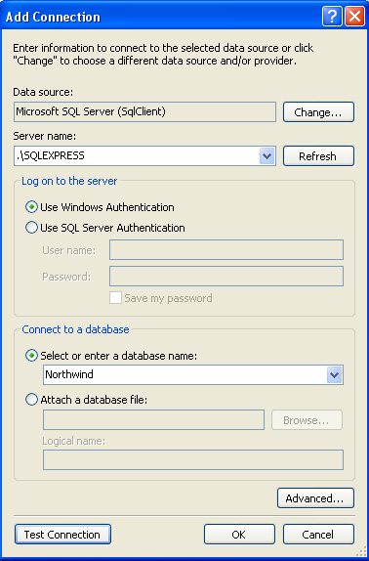
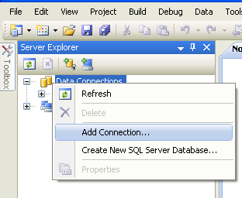
LINQ To SQL Designer (2)
1
3
4
2
Name of the server
Database Name

Slide 18
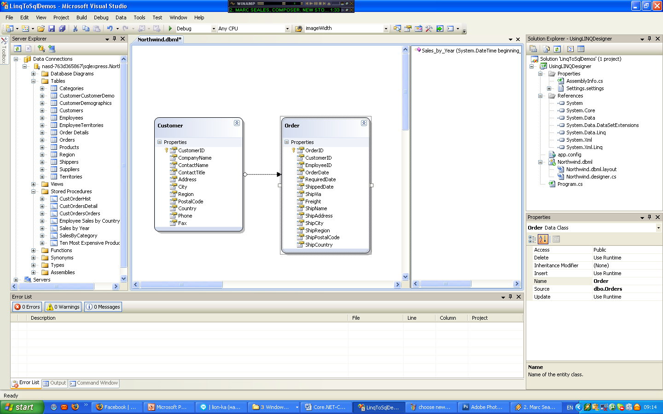
LINQ To SQL Designer (3)
5
Mapped stored procedures
Mapped tables

Slide 19
LINQ To SQL Designer
Live Demo

Slide 20
Using DataContext
Reading Data from
LINQ To SQL

Slide 21
Using DataContext
DataContext class generated by designer provides you:
  Ability to manipulate SQL data though entity classes (read, modify, delete, insert)
  Easily navigate through tables constraints
  Converting LINQ query into native SQL query
  Create new databases from current schema

Slide 22
Using DataContext (2)
First create instance of DataContext
NorthwindDataContext db = new NorthwindDataContext();
In constructor you can set connection and mapping source
DataContext properties
  Connection
  CommandTimeout
  Log – prints generated SQL queries to TextReader (ex. Console)

Slide 23
Using DataContext (2)
DataContext properties
  Transaction – set local transaction
  All Entity classes (tables) as properties
Reading Data From LINQ To SQL – as simple as reading from collection:
var customers = from c in db.Customers
where c.City=="London"
select c;

Slide 24
Reading With LINQ To SQL
Live Demo

Slide 25
Reading Data From SQL To LINQ - Example
NorthwindDataContext context =
new NorthwindDataContext();
//enable readonly mode
context.ObjectTrackingEnabled = false;
var orders = from o in context.Orders
where o.Customer.Country == "UK"
select o;
foreach (var item in orders)
Console.WriteLine("Order Dates To UK: " + item.OrderDate.Value.ToShortDateString());
Setting ObjectTrackingEnabled property to false improves performance by setting DataContext to read-only mode

Slide 26
Reading From More Than One Table
Live Demo

Slide 27
Inserting, Updating, Deleting With DataContext

Slide 28
Updating with DataContext
DataContext gives you ability to modify cells of different records in db by changing object properties
After making changes SubmitChanges() method must be called to make changes to the database
Order order = context.Orders.First();
order.OrderDate = DateTime.Now;
context.SubmitChanges();

Slide 29
Deleting with DataContext
Performed by using DeleteOnSubmit or DeleteAllOnSubmit() to the current entity class
SubmitChanges() method call is required to perform delete action
Order order = context.Orders.First();
//mark for delete on the next sumbit
context.Orders.DeleteOnSubmit(order);
context.SubmitChanges();

Slide 30
Inserting with DataContext
Performed by using InsertOnSubmit or InsertAllOnSubmit() to the current entity class
SubmitChanges() method call is required to perform insert action
//create new order object
Order customOrder = new Order()
{OrderDate = DateTime.Now,ShipName = "Titanic",
ShippedDate = new DateTime(1912, 4, 15),ShipCity = "Bottom Of The Ocean"};
//mark to be insert on the next submit
context.Orders.InsertOnSubmit(customOrder);
context.SubmitChanges();

Slide 31
Manipulating Data with DataContext
Live Demo

Slide 32
Executing SQL query with DataContext
You can execute SQL query through DataContext and convert the result to the corresponding class
Performed with ExecuteQuery() method
NorthwindDataContext context = new NorthwindDataContext();
var customers = context
.ExecuteQuery<Customer>("select * from Customers where City='London'");
foreach (var item in customers)
Console.WriteLine(String.Format("Company:{0}, Phone:{1}",item.CompanyName, item.Phone));

Slide 33
Executing SQL Query with DataContext
Live Demo

Slide 34
LINQ To SQL – Other Features
Using LINQ To SQL you can also:
  Creating or deleting databases or tables
  Map Views Stored Procedures ect.
  Create compiled queries - used when executing same parameterized query multiple times

Slide 35
LINQ To SQL
Questions?

Slide 36
Exercises
Using Visual Studio designer create a DataContext to Northwind Sample Database
Create a class with static methods (DAO) which provide functionality for inserting, modifying and deleting customers.
Write a method that extracts all customers whose has orders in 1996 and has title "owner".
Create duplicate database called NotrhwindTwin using DataContext features. Hint: Check for the method in MSDN

Slide 37
Exercises (2)
Implement Ex.3 by using SQL query executing it by DataContext.
Write a method that selects territories for a given employee and one that selects employees in given territory
Hard: Create a class which allows employee entity to access corresponding territories as property (EntitySet or IEnumerable) and vice versa.

